Slide 1
DR.SNSRCAS, CBE
SUBJECT: CLOUD TECHNOLOGY FUNDAMENTALS
COURSE CODE:21UCA501 UNIT - V
TITLE: Management responsibilities
YEAR: III SEMESTER 2022-2023 (ODD)

Slide 2
Management responsibilities
What separates a network management package from a cloud computing management package is the “cloudly” characteristics that cloud management service must have:

Slide 3
Management responsibilities
Billing is on a pay-as-you-go basis.
The management service is extremely scalable.
The management service is ubiquitous.
Communication between the cloud and other systems uses cloud networking standards.

Slide 4
Management responsibilities
To monitor an entire cloud computing deployment stack, you monitor six different categories:
1. End-user services such as HTTP, TCP, POP3/SMTP, and others
2. Browser performance on the client
3. Application monitoring in the cloud, such as Apache, MySQL, and so.

Slide 5
Management responsibilities
4. Cloud infrastructure monitoring of services such as Amazon Web Services, GoGrid, Rackspace, and others
5. Machine instance monitoring where the service measures processor utilization, memory usage, disk consumption, queue lengths, and other important parameters

Slide 6
Management responsibilities
6. Network monitoring and discovery using standard protocols like the Simple Network Management Protocol (SNMP), Configuration Management Database (CMDB), Windows
Management Instrumentation (WMI), and the like

Slide 7
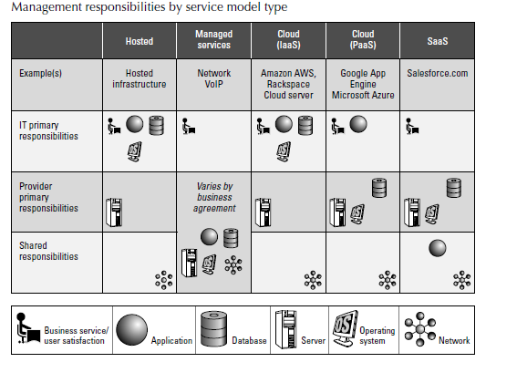
Management responsibilities

Slide 8
Management responsibilities
It’s important to note that there are really two aspects to cloud management:
1. Managing resources in the cloud
2. Using the cloud to manage resources on-premises

Slide 9
Cloud Management Products
some of the current players in this market, along with the products they either are offering or are promising in the very near future.
When considering products in cloud
management, you should be aware
that—as in all new areas of technology—there is considerable churn as companies grow, get acquired

Slide 10
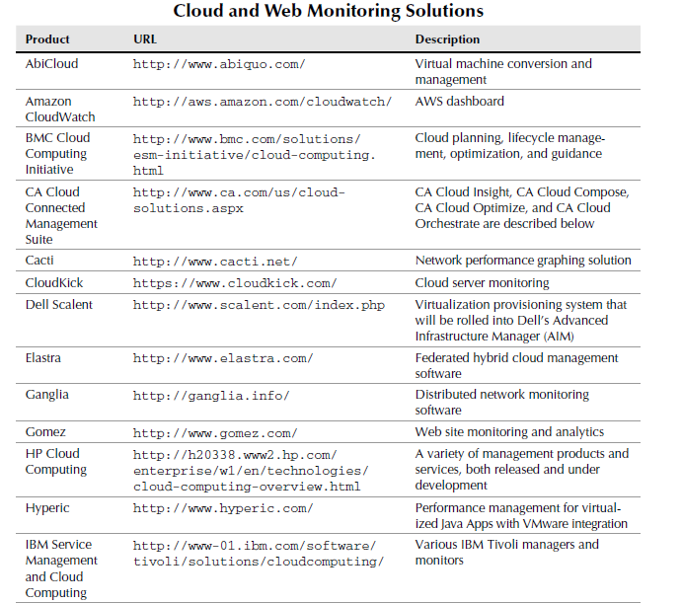
Cloud Management Products

Slide 11
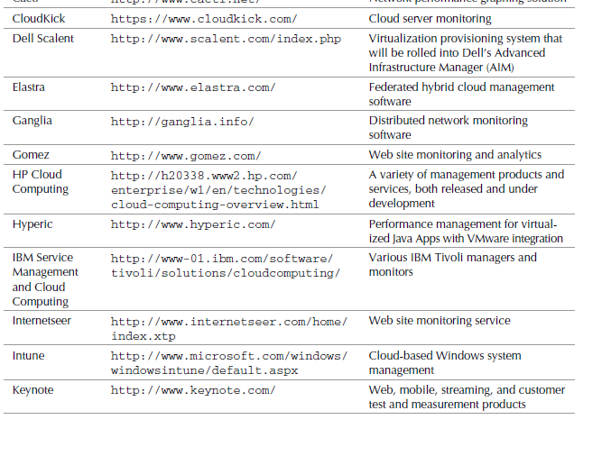
Cloud Management Products

Slide 12
Cloud Management Products
Administration Console provides you with the following monitoring capabilities:
Create a new application, and set it up in your domain.
Invite other people to be part of developing your application.
View data and error logs.
Analyze your network traffic.
Browse the application data store, and manage its indexes.
View the application’s scheduled tasks.
Test the application, and swap out versions.

Slide 13
Thank You

